Slide 1

Geomorphology and Climate Change
Here is where your presentation begins

Slide 2

Climate story writers
"Through the power of storytelling, Climate Story Writers transforms the facts of climate change into a call for action and hope."

Slide 3
01
02
Table of contents
04
03
Timeline of climate change
Introduction
Future recommendation
Conclusion

Slide 4
Table of contents
01
02
03
04
Introduction
Timeline of climate change
Conclusion
Future recommendation

Slide 5
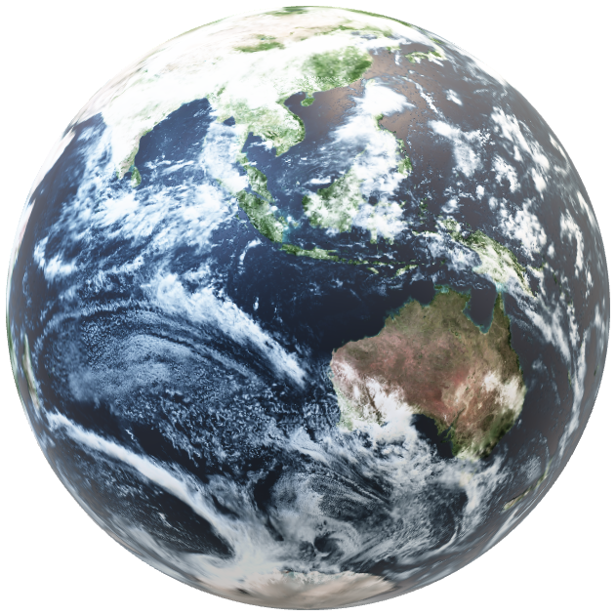
02
Table of contents
01
04
03
Timeline of climate change
Introduction
Conclusion
Future recommendation

Slide 6
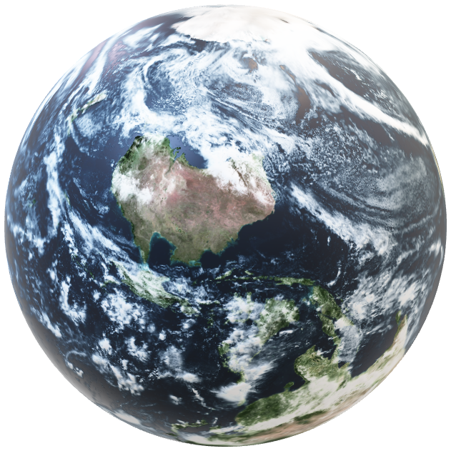
02
Table of contents
01
04
03
Timeline of climate change
Introduction
Conclusion
Future recommendation

Slide 7
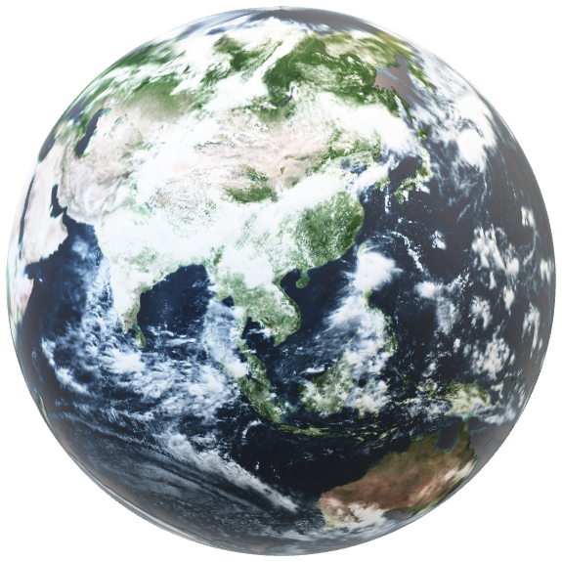
Introduction
Good evening, everyone.
We're excited to present our project. Our team participated in the NASA Space Apps challenge and chose to focus on climate change storytelling according to our passion.
Our goal was to create a powerful and engaging way to raise awareness about the urgent issue of climate change. We believe that using simplicity to present information in an eye-catching and creative way will increase people’s enthusiasm and attract them more, making them curious to discover more about the issue and its details.
Our project consists of two main components: a website and an app. They serve as a digital time capsule, providing information about climate change throughout history and offering an interactive and immersive experience, allowing users to explore the stories of our extinct narrators in more detail.

Slide 8
02
Timeline of climate change

Slide 9
Timeline of climate change
Climate in ACE
Climate in BCE

Slide 10
Timeline of climate change
Climate in BCE
Climate in ACE

Slide 11
Timeline of climate change
Our website and app are divided into several parts:
The first part talks about climate change in the B.C.E. era, including its characteristics such as cold climate and low sea level, its causes, effects, and duration, such as in the last glacial maximum, the early Holocene era, and many other eras.
The second part talks about climate change in the A.D. era, starting with the Early Common Era, with its characteristics, causes, and the impact of climate change on it until the twenty-first century and the current time.
Climate in ACE
Climate in BCE

Slide 12
Timeline of climate change
One of the most important parts that our website also discusses are the problems resulting from climate change and the seriousness of each problem, such as the warming of the oceans, the rise in atmospheric temperatures, the shrinking of ice sheets, the retreat of glaciers, and many other serious problems.
Climate in ACE
Climate in BCE

Slide 13
Timeline of climate change
The fun part is when we discuss climate change through a story told by the sun about extinct animals such as mammoths, dinosaurs and many other creatures that have disappeared. We will explore the sudden changes that led to their extinction and then see them travel through time to the future to warn humans about the importance of addressing climate change. The goal of this form of the story is to be simpler than the scientific parts and thus benefit the largest possible number of people such as children and to remind humans not to ignore this disaster in order to avoid facing extinction like these creatures. The last part is to join us, and this is where we conducted a survey to know people’s ideas about climate change, and thus we can develop more accordingly and know if anyone would like to participate with us.
Climate in ACE
Climate in BCE

Slide 14

Raising Awareness and Inspiring Action
The goal of our project is to spread awareness among the largest possible number of people, students, policy makers and the general public, about the importance of the disaster we are dealing with, which is climate change, so that we can confront it and solve it before it is too late.

Slide 15
03
Future recommendations

Slide 16
03
Future recommendations

Slide 17
Future recommendations
Interactive Storytelling: Allow users to choose their own narrative path or influence the outcome
Prediction Tools: Develop tools that allow users to explore potential future climate scenarios.
Gamification: Incorporate game elements, such as challenges or rewards, to motivate user participation.
Location-Based Features: Utilize GPS to provide location-specific climate data and information.
Augmented Reality: Create immersive experiences that allow users to visualise climate change impacts in their own surroundings.
Offline Accessibility: Ensure the app can be used without an internet connection for accessibility in remote areas.

Slide 18
04
Conclusion

Slide 19
04
Conclusion

Slide 20
Conclusion
In conclusion, our project aims to raise awareness about the urgent issue of climate change through a unique and engaging approach. By combining historical information, interactive elements, and storytelling, we hope to inspire individuals to take action and contribute to a more sustainable future.
We believe that our project has the potential to make a significant impact. By providing accessible and informative content, we aim to empower people to understand the complexities of climate change and its consequences. Through the storytelling aspect, we hope to evoke empathy and inspire a sense of responsibility to protect our planet.
We invite you to explore our website and app further and share our project with others. Together, we can create a more sustainable future for generations to come.

Slide 21
Thank you!

Slide 22
Thank you!
Team members:
Yousef Amir Shamsaldeen
Mahmoud Elnaqeb
Yousef Attia Abdelaziz
Joudy Ahmed Yassin
Rahma Mohamed

